Slide 1



New Site Composer
Dr. Carsten Leue

Slide 2

Agenda
Introduction
1
Architecture
2
Demo
3

Slide 3
Disclaimer
The presentations shows work in progress. UX and implementation details may change for the final release.
This is NOT a delivery commitment.

Slide 4



“A Site is structured content with a concise, configurable visualization.”

Slide 5

Meet Keiko Content Creator
Tasks and responsibilities
Create visual and text assets to be used across multiple communications.
Manage storage of visual and text assets.
Coordinate with strategic marketers to plan content strategy.
Goals
Create content which excites their users and stays true to brand.
Skills
No HTML/CSS skills

Slide 6

Meet Krysta Content Assembler
Tasks and responsibilities
She coordinates with internal/external stakeholders
She tracks edits to & approvals of content
Goals
Manage the Site
Make changes to marketing communications layouts/templates easily and efficiently
Skills
Has basic-to-intermediate knowledge of HTML/CSS
No coding skills

Slide 7

Meet Fernando Front-end Developer
Tasks and responsibilities
Takes designs and codes them into artifacts, using HTML, JavaScript and CSS
Receives a design as a PSD or image file. Sometimes it will come with written specs and instructions but not always.
Goals
Implement complex site content and reusable components
Skills
Codes with HTML, CSS, JavaScript. Possibly with PHP.
Skilled in frameworks such as Angular or React

Slide 8

The sites-next Value Proposition
Keiko and Krysta can create a viable UI using an intuitive browser based tooling
Create pages with content
Select from a rich set of configurable content blocks
Add and re-arrange content blocks using drag-and-drop
Krysta can contribute new content blocks
Based on simple templates and styles
No coding required
Fernando can contribute complex component
Application blocks using state-of-the-art JS frameworks
Page templates, Styles, themes, …

Slide 9
The sites-next Value Proposition
Search Engine Optimized
Ranking: Site author is able to control SEO URLs + page meta data
Crawlability: Pages can be discovered and crawled by search crawlers
Top Performance
Single Page App based on latest technology
Fast Editing Performance so using it is fun, again
Integration with CDN for best cache-ability
Fits with the Acoustic Content management concepts
Workflow, preview, approvals, versioning, libraries, projects

Slide 10
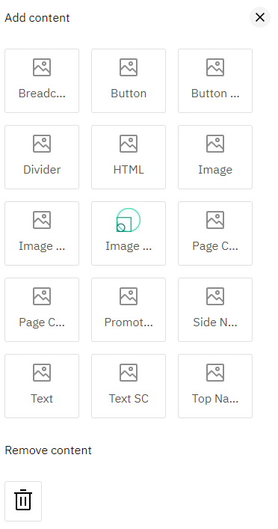
The sites-next Building Blocks
Content Model
Content type, items, layouts
Application Model
Simple content blocks based on handlebars templates
Versatile application blocks based on JS framework
Modular API for the web developer
Best of server- and client side rendering combined
Inline Edit Model
In-place edit capabilities for content including drag-and-drop
In-context authoring shell for site artifacts

Slide 11



The sites-next Rendering Model
Initial Request →
Server Side Rendering
← pre-rendered HTML
Content Model
bootstrap
n^{th}
Client Side Application
REST APIs
Caching Proxy

Slide 12
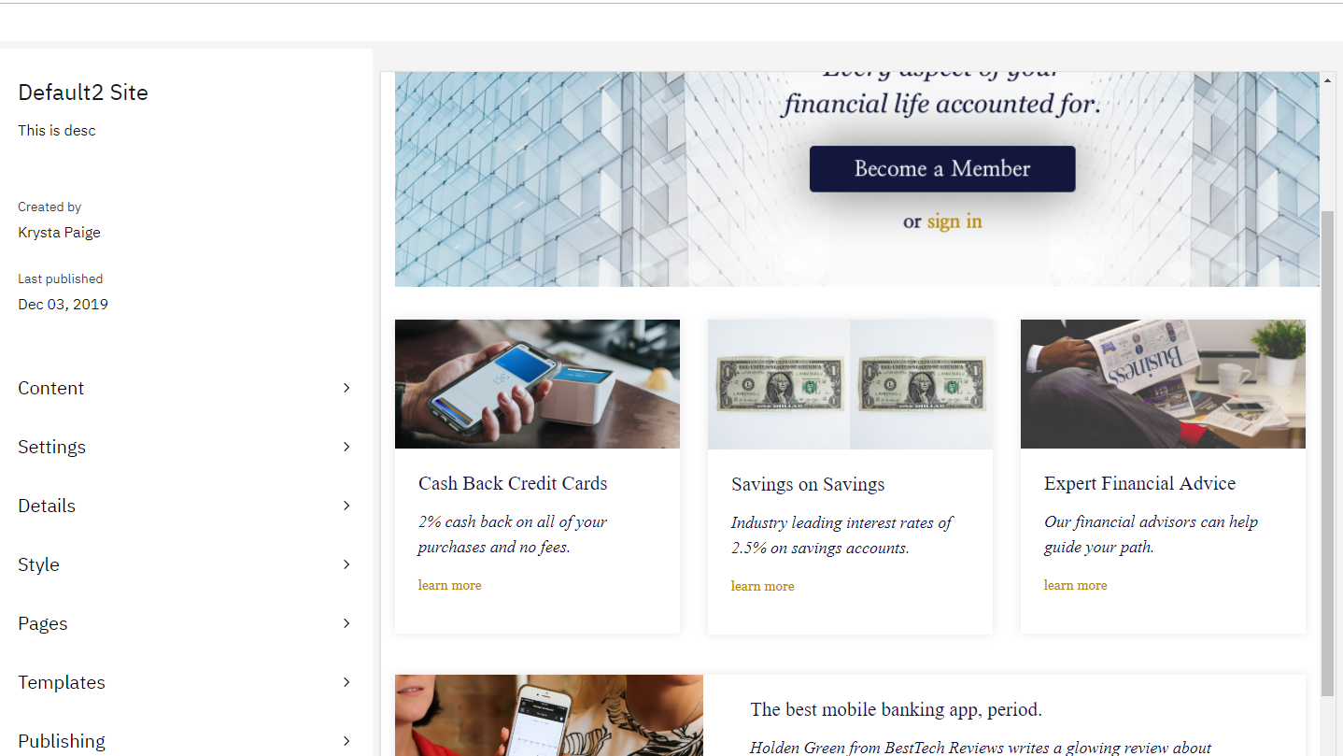

DEMO

Slide 13
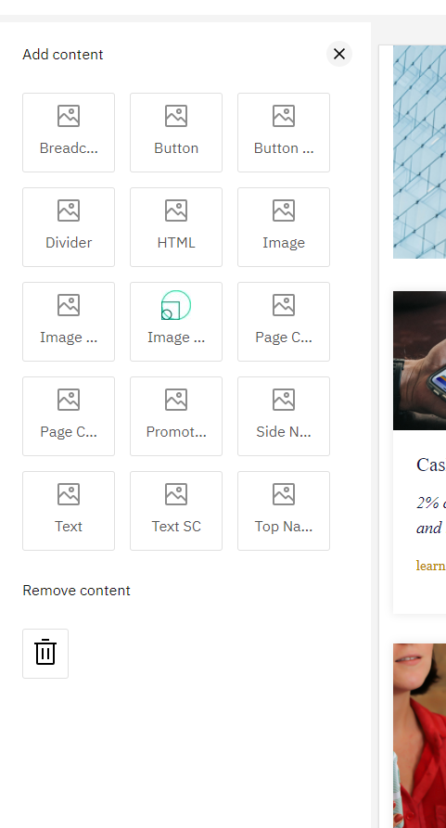
Page Blocks
Simple Blocks
Based on handlebars templates, i.e. little logic, markup centric
Can be mastered with HTML/CSS skills only
Same HBS can be rendered client side and server side
Extensible by uploading a text file, no application compilation required
Application Blocks
Angular components, optionally using a acoustic content API
Good for complex components such as charts, carousels, etc

Slide 14

Page Layout
Add content via the palette
Re-arrange page blocks using drag-and drop

Slide 15
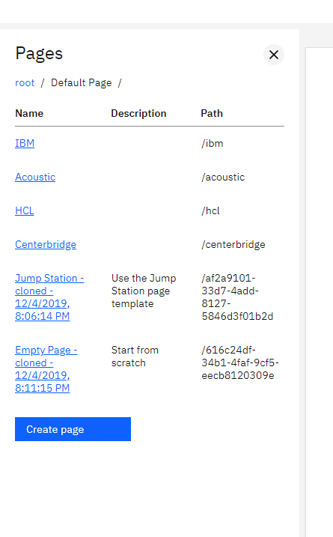
Page Creation
Tree Control
Visualization of the page hierarchy
Drag-and-drop
Inplace-edit for common page properties
Page Creation
Based on page templates

